Slide 1
Project Name: Burpien
Company Name: NoLikie
Team Members: Wael Alghamdi and Alan Ayala

Slide 2
App Description
This app is aimed towards solving the problem of cashier software not being flexible enough. This app is customizable to a degree and will not require the client to reach for the developers for changes in the look and feel(function) of the app. They could do the changes themselves.

Slide 3
App Description (cont.)
To develop the app, we visited various food chains and examined their menu screens. After that, we reached to the conclusion that no system was perfect, hence the goal of this app. The way its made it resembles current food ordering systems of places like Chartwells and Hallal Guys.

Slide 4
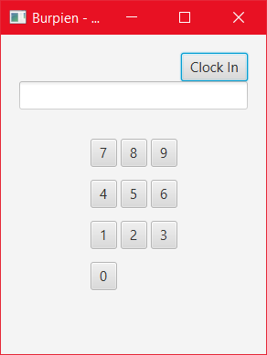
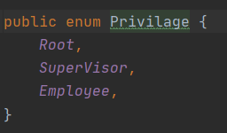
Log In Page with Credentials

Slide 5
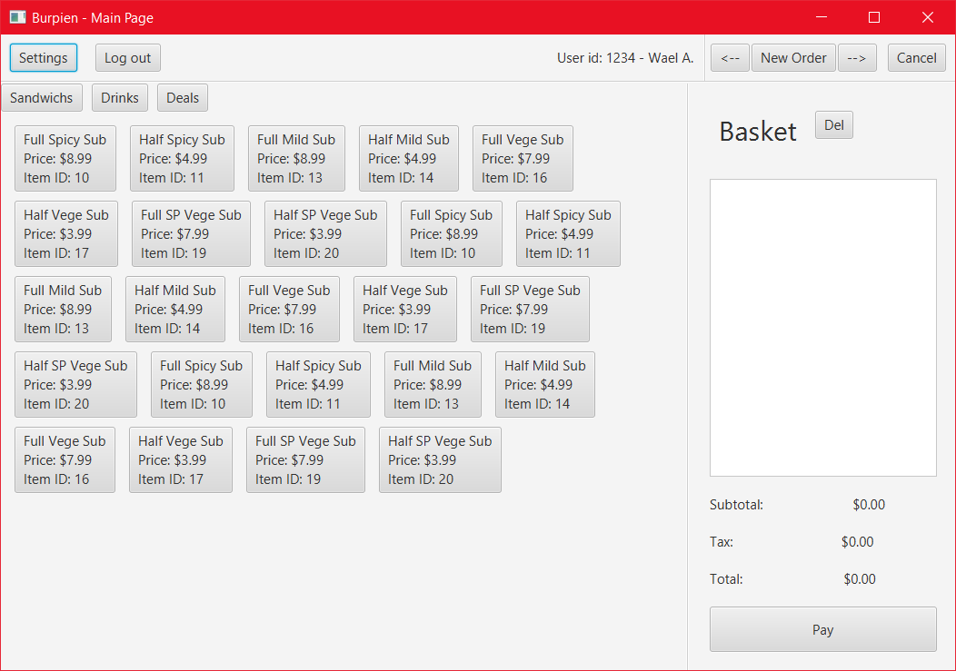

Slide 6


Slide 7
